Slide 1
SQL developments: an overview
In 1986, ANSI and ISO published an initial standard for SQL: SQL-86 or SQL1
In 1992, first major revision to ISO standard occurred, referred to as SQL2 or SQL-92
In 1999, SQL-99 (SQL3) was released with support for object-oriented data management
In late 2003, SQL-2003 was released
Now: SQL-2006 was published
Chapter 2-1
Slide 2 -<number>

Slide 2
Basic SQL
SQL Data Definition & Data Types
Specifying Constraints in SQL
Basic Retrieval Queries in SQL
INSERT, DELETE, UPDATE
Slide 2-<number>

Slide 3
SQL
DDL: Create, Alter, Drop
DML: Select, Insert, Update, Delete
DCL: Commit, Rollback, Grant, Revoke
Chapter 2-<number>
Slide 2 -<number>

Slide 4
CREATE SCHEMA
Started with SQL 92
A SQL Schema: is to group together tables and other constructs that belong to the same database application
CREATE SCHEMA SchemaName AUTHORIZATION AuthorizationIdentifier
Slide 2 -<number>

Slide 5
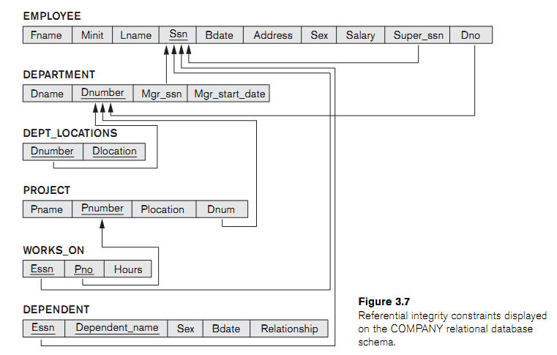
5.7
Slide 2-<number>

Slide 6
CREATE TABLE
Specifies a new base relation by giving it a name, and specifying each of its attributes and their data types (INTEGER, FLOAT, DECIMAL(i,j), CHAR(n), VARCHAR(n))
A constraint NOT NULL may be specified on an attribute
CREATE TABLE DEPARTMENT
( DNAME VARCHAR(10) NOT NULL,
DNUMBER INTEGER NOT NULL,
MGRSSN CHAR(9),
MGRSTARTDATE CHAR(9) );
Slide 2 -<number>

Slide 7
CREATE TABLE
CREATE TABLE Company.TableName …
or
CREATE TABLE TableName …
Slide 2 -<number>

Slide 8
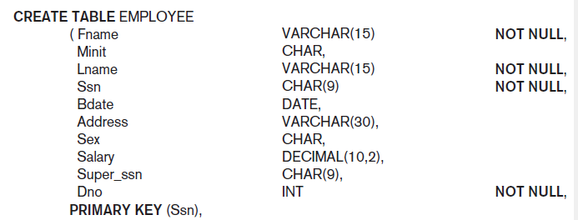
Slide 2 -<number>

Slide 9
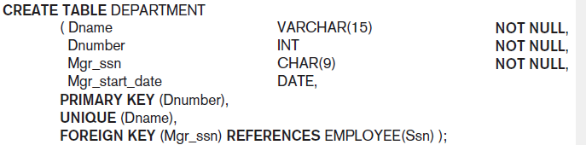
Slide 2 -<number>

Slide 10
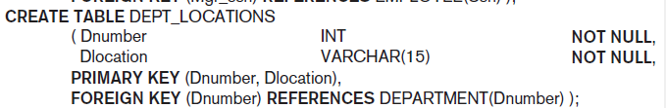
Slide 2 -<number>

Slide 11
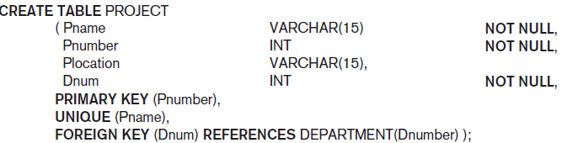
Slide 2 -<number>

Slide 12
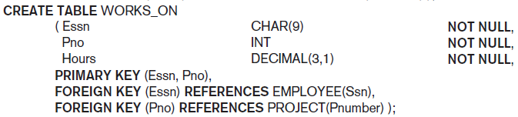
Slide 2 -<number>

Slide 13
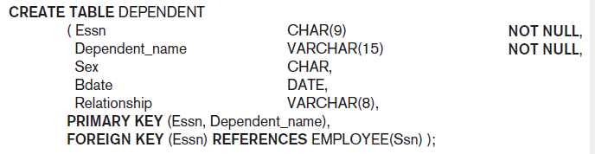
Slide 2 -<number>

Slide 14
Data Types
Numeric: INT or INTEGER, FLOAT or REAL, DOUBLE PRECISION, …
Character string: fixed length CHAR(n), varying length VARCHAR(n)
Bit string: BIT(n), e.g. B’1001’
Boolean: true, false or NULL
DATE: Made up of year-month-day in the format yyyy-mm-dd
TIME: Made up of hour:minute:second in the format hh:mm:ss
TIME(i): Made up of hour:minute:second plus i additional digits specifying fractions of a second format is hh:mm:ss:ii...i
TIMESTAMP: Has both DATE and TIME components
Slide 2 -<number>

Slide 15
Data Types
A domain can be declared and used with the attribute specification
CREATE DOMAIN DomainName AS DataType [CHECK conditions];
Example:
Slide 2 -<number>

Slide 16
CREATE TABLE
  CREATE TABLE TableName
  {(colName dataType [NOT NULL] [UNIQUE]
  [DEFAULT defaultOption]
  [CHECK searchCondition] [,...]}
  [PRIMARY KEY (listOfColumns),]
  {[UNIQUE (listOfColumns),] […,]}
  {[FOREIGN KEY (listOfFKColumns)
  REFERENCES ParentTableName [(listOfCKColumns)],
  [ON UPDATE referentialAction]
  [ON DELETE referentialAction ]] [,…]}
  {[CHECK (searchCondition)] [,…] })
Slide 2 -<number>

Slide 17
Specifying Constraints in SQL
Specifying Attribute Constraints and Attribute Defaults
Default values
  DEFAULT <value> can be specified for an attribute
  If no default clause is specified, the default value is NULL for attributes that do not have the NOT NULL constraint
CHECK clause: restrict attribute or domain values
  DNUMBER INT NOT NULL CHECK (DNUMBER>0 AND DNUMBER<21);
  CREATE DOMAIN can also be used in conjunction with the CHECK clause:
  CREATE DOMAIN D_NUM AS INTEGER CHECK (D_NUM>0 AND D_NUM<21);
Slide 2 -<number>

Slide 18
CREATE TABLE EMPLOYEE
( … ,
Dno INT NOT NULL DEFAULT 1,
CONSTRAINT EMPPK
PRIMARY KEY (Ssn),
CONSTRAINT EMPSUPERFK
FOREIGN KEY (Super_ssn) REFERENCES EMPLOYEE(Ssn)
ON DELETE SET NULL ON UPDATE CASCADE,
CONSTRAINT EMPDEPTFK
FOREIGN KEY(Dno) REFERENCES DEPARTMENT(Dnumber)
ON DELETE SET DEFAULT ON UPDATE CASCADE);
Slide 2 -<number>

Slide 19
CREATE TABLE DEPARTMENT
( … ,
Mgr_ssn CHAR(9) NOT NULL DEFAULT ‘888665555’,
… ,
CONSTRAINT DEPTPK
PRIMARY KEY(Dnumber),
CONSTRAINT DEPTSK
UNIQUE (Dname),
CONSTRAINT DEPTMGRFK
FOREIGN KEY (Mgr_ssn) REFERENCES EMPLOYEE(Ssn)
ON DELETE SET DEFAULT ON UPDATE CASCADE);
CREATE TABLE DEPT_LOCATIONS
( … ,
PRIMARY KEY (Dnumber, Dlocation),
FOREIGN KEY (Dnumber) REFERENCES DEPARTMENT(Dnumber)
ON DELETE CASCADE ON UPDATE CASCADE);
Slide 2 -<number>

Slide 20
Specifying Constraints in SQL
Specifying Key Constraints
Key attributes can be specified via the PRIMARY KEY and UNIQUE phrases
CREATE TABLE DEPT
  ( DNAME VARCHAR(10) NOT NULL,
  DNUMBER INTEGER NOT NULL,
  MGRSSN CHAR(9),
  MGRSTARTDATE CHAR(9),
  PRIMARY KEY (DNUMBER),
  UNIQUE (DNAME),
  FOREIGN KEY (MGRSSN) REFERENCES EMP );
Or Dnumber INTEGER PRIMARY KEY;
Slide 2 -<number>

Slide 21
REFERENTIAL INTEGRITY OPTIONS
Specifying Referential Integrity Constraints: FOREIGN KEY clause. Can specify RESTRICT, CASCADE, SET NULL or SET DEFAULT on referential integrity constraints
CREATE TABLE DEPT
( DNAME VARCHAR(10) NOT NULL,
DNUMBER INTEGER NOT NULL,
MGRSSN CHAR(9),
MGRSTARTDATE CHAR(9),
PRIMARY KEY (DNUMBER),
UNIQUE (DNAME),
FOREIGN KEY (MGRSSN) REFERENCES EMP
ON DELETE SET DEFAULT ON UPDATE CASCADE );
Slide 2 -<number>

Slide 22
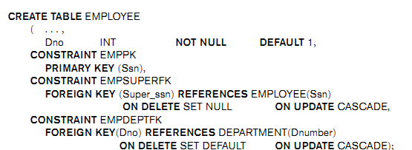
Specifying Constraints in SQL
Giving names to constraints
Slide 2 -<number>

Slide 23

Specifying Constraints in SQL
Specifying Constraints on Tuples (tuple-based) using CHECK: at the end of CREATE TABLE
Example:
Slide 2 -<number>

Slide 24
Schema Change Statements in SQL
The DROP command
DROP SCHEMA COMPANY CASCADE;
DROP TABLE DEPENDENT CASCADE;
Slide 2 -<number>

Slide 25
The ALTER command
ALTER TABLE COMPANY.EMPLOYEE ADD COLUMN JOB VARCHAR(12);
ALTER TABLE COMPANY.EMPLOYEE DROP COLUMN ADDRESS CASCADE;
Slide 2 -<number>

Slide 26
ALTER TABLE COMPANY.DEPARTMENT ALTER COLUMN MGR_SSN DROP DEFAULT;
ALTER TABLE COMPANY.DEPARTMENT ALTER COLUMN MGR_SSN SET DEFAULT ‘333445555’
ALTER TABLE COMPANY.EMPLOYEE DROP CONSTRAINT EMPSUPERFK CASCADE;
Slide 2 -<number>

Slide 27
Basic Retrieval Queries in SQL
SELECT statement
SQL relation (table) is a multi-set (sometimes called a bag) of tuples; it is not a set of tuples
SQL relations can be constrained to be sets by specifying PRIMARY KEY or UNIQUE attributes, or by using the DISTINCT option in a query
Slide 2 -<number>

Slide 28
Basic Retrieval Queries in SQL (cont.)
Basic form of the SQL SELECT statement is called a mapping or a SELECT-FROM-WHERE block
  SELECT <attribute list>
  FROM <table list>
  WHERE <condition>
  <attribute list> is a list of attribute names whose values are to be retrieved by the query
  <table list> is a list of the relation names required to process the query
  <condition> is a conditional (Boolean) expression that identifies the tuples to be retrieved by the query
Slide 2 -<number>

Slide 29

Relational Database Schema
Slide 2 -<number>

Slide 30

Populated Database
Slide 2 -<number>

Slide 31
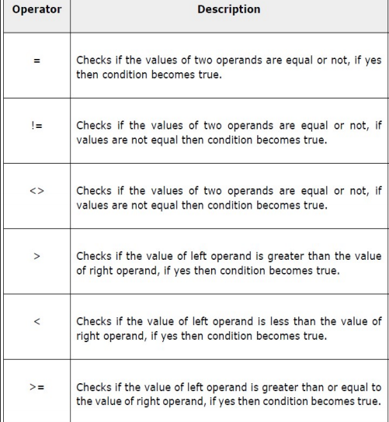
SQL Comparison Operators:
Slide 2 -<number>

Slide 32
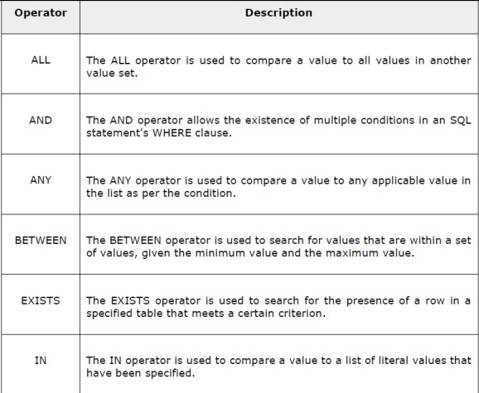
SQL Logical Operators:
Slide 2 -<number>

Slide 33
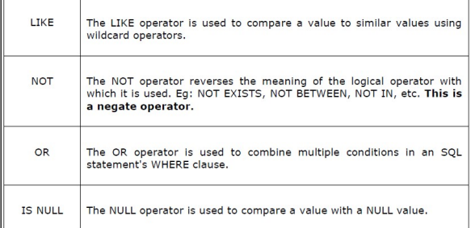
Contd:
Slide 2 -<number>

Slide 34
Simple SQL Queries
All subsequent examples use the COMPANY database
Example of a simple query on one relation
Query 0: Retrieve the birthdate and address of the employee whose name is 'John B. Smith'.
  Q0: SELECT BDATE, ADDRESS
  FROM EMPLOYEE
  WHERE FNAME='John' AND MINIT='B’
  AND LNAME='Smith’
  The SELECT-clause specifies the projection attributes and the WHERE-clause specifies the selection condition
  The result of the query may contain duplicate tuples
Slide 2 -<number>

Slide 35
Simple SQL Queries (cont.)
Query 1: Retrieve the name and address of all employees who work for the 'Research' department.
  Q1: SELECT FNAME, LNAME, ADDRESS
  FROM EMPLOYEE, DEPARTMENT
  WHERE DNAME='Research' AND DNUMBER=DNO
  (DNAME='Research') is a selection condition
  (DNUMBER=DNO) is a join condition
Slide 2 -<number>

Slide 36
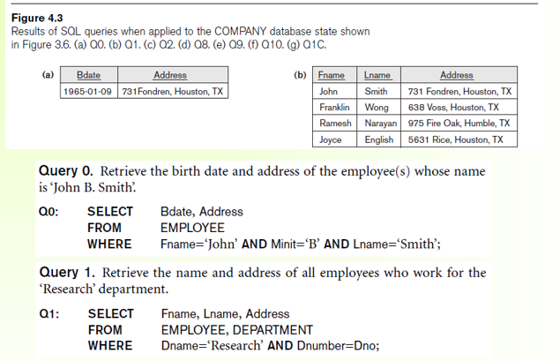

Slide 37
Simple SQL Queries (cont.)
Query 2: For every project located in 'Stafford', list the project number, the controlling department number, and the department manager's last name, address, and birthdate.
  Q2: SELECT PNUMBER, DNUM, LNAME, BDATE, ADDRESS
  FROM PROJECT, DEPARTMENT, EMPLOYEE
  WHERE DNUM=DNUMBER AND MGRSSN=SSN AND PLOCATION='Stafford'
  In Q2, there are two join conditions
  The join condition DNUM=DNUMBER relates a project to its controlling department
  The join condition MGRSSN=SSN relates the controlling department to the employee who manages that department
Slide 2 -<number>

Slide 38
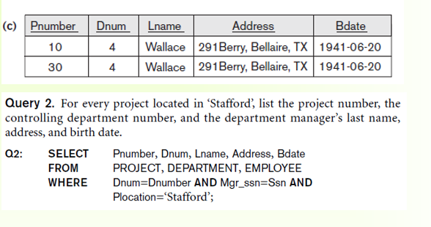

Slide 39
Aliases, * and DISTINCT, Empty WHERE-clause
In SQL, we can use the same name for two (or more) attributes as long as the attributes are in different relations
A query that refers to two or more attributes with the same name must qualify the attribute name with the relation name by prefixing the relation name to the attribute name
Example:
EMPLOYEE.LNAME, DEPARTMENT.DNAME
Slide 2 -<number>

Slide 40
ALIASES
Some queries need to refer to the same relation twice
In this case, aliases are given to the relation name
Query 8: For each employee, retrieve the employee's name, and the name of his or her immediate supervisor.
Q8: SELECT E.FNAME, E.LNAME, S.FNAME, S.LNAME
FROM EMPLOYEE E S
WHERE E.SUPERSSN=S.SSN
  In Q8, the alternate relation names E and S are called aliases or tuple variables for the EMPLOYEE relation
  We can think of E and S as two different copies of EMPLOYEE; E represents employees in role of supervisees and S represents employees in role of supervisors
Slide 2 -<number>

Slide 41
ALIASES (cont.)
Aliasing can also be used in any SQL query for convenience
Can also use the AS keyword to specify aliases
Q8: SELECT E.FNAME, E.LNAME, S.FNAME, S.LNAME
FROM EMPLOYEE AS E, EMPLOYEE AS S
WHERE E.SUPERSSN=S.SSN
Slide 2 -<number>

Slide 42
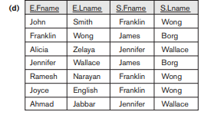
Q8: SELECT E.FNAME, E.LNAME, S.FNAME, S.LNAME
FROM EMPLOYEE E S
WHERE E.SUPERSSN=S.SSN
Q8: SELECT E.FNAME, E.LNAME, S.FNAME, S.LNAME
FROM EMPLOYEE AS E, EMPLOYEE AS S
WHERE E.SUPERSSN=S.SSN

Slide 43
UNSPECIFIED
WHERE-clause
A missing WHERE-clause indicates no condition; hence, all tuples of the relations in the FROM-clause are selected
This is equivalent to the condition WHERE TRUE
Query 9: Retrieve the SSN values for all employees.
  Q9: SELECT SSN
  FROM EMPLOYEE
If more than one relation is specified in the FROM-clause and there is no join condition, then the CARTESIAN PRODUCT of tuples is selected
Slide 2 -<number>

Slide 44
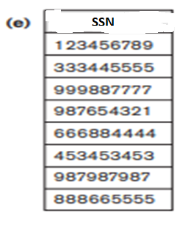
Q9: SELECT SSN
FROM EMPLOYEE

Slide 45
UNSPECIFIED
WHERE-clause (cont.)
Example:
Q10: SELECT SSN, DNAME
FROM EMPLOYEE, DEPARTMENT
  It is extremely important not to overlook specifying any selection and join conditions in the WHERE-clause; otherwise, incorrect and very large relations may result
Slide 2 -<number>

Slide 46
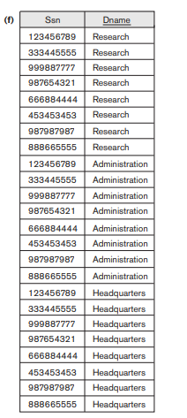
SELECT SSN, DNAME
FROM EMPLOYEE, DEPARTMENT

Slide 47
USE OF *
To retrieve all the attribute values of the selected tuples, a * is used, which stands for all the attributes
Examples:
Q1C: SELECT *
FROM EMPLOYEE
WHERE DNO=5
Q1D: SELECT *
FROM EMPLOYEE, DEPARTMENT
WHERE DNAME='Research' AND DNO=DNUMBER
Slide 2 -<number>

Slide 48
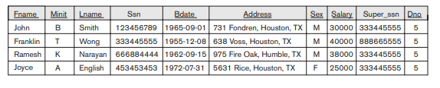
Q1C: SELECT *
FROM EMPLOYEE
WHERE DNO=5

Slide 49
USE OF DISTINCT
SQL does not treat a relation as a set; duplicate tuples can appear
To eliminate duplicate tuples in a query result, the keyword DISTINCT is used
For example, the result of Q11 may have duplicate SALARY values whereas Q11A does not have any duplicate values
Q11: SELECT SALARY
FROM EMPLOYEE
Q11A: SELECT DISTINCT SALARY
FROM EMPLOYEE
Slide 2 -<number>

Slide 50
SELECT SALARY
FROM EMPLOYEE;
SELECT DISTINCT SALARY
FROM EMPLOYEE;
SELECT ALL SALARY
FROM EMPLOYEE;

Slide 51
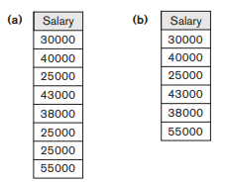

Slide 52
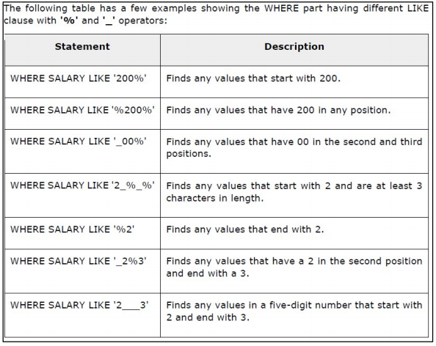
SUBSTRING COMPARISON OPERATORS:
Slide 2 -<number>

Slide 53
SUBSTRING COMPARISON
The LIKE comparison operator is used to compare partial strings
'%' (or '*' in some implementations) replaces an arbitrary number of characters
'_' replaces a single arbitrary character
Slide 2 -<number>

Slide 54
SUBSTRING COMPARISON (cont.)
Query 25: Retrieve all employees whose address is in Houston, Texas. Here, the value of the ADDRESS attribute must contain the substring 'Houston,TX'.
Q25: SELECT FNAME, LNAME
FROM EMPLOYEE
WHERE ADDRESS LIKE '%Houston,TX%’
Slide 2 -<number>

Slide 55
SUBSTRING COMPARISON (cont.)
Query 26: Retrieve all employees who were born during the 1950s.
With each underscore as a place holder for a single arbitrary character.
Q26: SELECT Fname, Lname
FROM EMPLOYEE WHERE
Bdate LIKE ‘_ _ 5 _ _ _ _ _ _ _’ ;
The LIKE operator allows us to get around the fact that each value is considered atomic and indivisible; hence, in SQL, character string attribute values are not atomic
Slide 2 -<number>

Slide 56
ARITHMETIC OPERATIONS
The standard arithmetic operators '+', '-'. '*', and '/‘ can be applied to numeric values in an SQL query result
Query 27: Show the effect of giving all employees who work on the 'ProductX' project a 10% raise.
Q27: SELECT FNAME, LNAME, 1.1*SALARY
FROM EMPLOYEE, WORKS_ON, PROJECT
WHERE SSN=ESSN AND PNO=PNUMBER AND PNAME='ProductX’
Slide 2 -<number>

Slide 57
Query 14. Retrieve all employees in department 5 whose salary is between $30,000 and $40,000.
SELECT *
FROM EMPLOYEE
WHERE (Salary BETWEEN 30000 AND 40000) AND Dno = 5;
The condition (Salary BETWEEN 30000 AND 40000) in Q14 is equivalent to the condition
((Salary >= 30000) AND (Salary <= 40000)).
Slide 2 -<number>

Slide 58
Ordering of Query Results
Query 15. Retrieve a list of employees and the projects they are working on, ordered by department and, within each department, ordered alphabetically by last name, then first name.
Slide 2 -<number>

Slide 59
SELECT D.Dname, E.Lname, E.Fname, P.Pname
FROM DEPARTMENT AS D, EMPLOYEE AS E, WORKS_ON AS W,
PROJECT AS P
WHERE D.Dnumber = E.Dno AND E.Ssn = W.Essn AND W.Pno =
P.Pnumber
ORDER BY D.Dname, E.Lname, E.Fname;
ORDER BY D.Dname DESC, E.Lname ASC, E.Fname ASC
Slide 2 -<number>

Slide 60
Specifying Updates in SQL
There are three SQL commands to modify the database; INSERT, DELETE, and UPDATE
Slide 2 -<number>

Slide 61
INSERT
To add one or more tuples to a relation
Attribute values should be listed in the same order as the attributes were specified in the CREATE TABLE command
Slide 2 -<number>

Slide 62
INSERT (cont.)
Example:
U1: INSERT INTO EMPLOYEE
VALUES ('Richard','K','Marini', '653298653', '30-DEC-52',
'98 Oak Forest,Katy,TX', 'M', 37000,'987654321', 4 )
An alternate form of INSERT specifies explicitly the attribute names that correspond to the values in the new tuple
Attributes with NULL values can be left out
Example: Insert a tuple for a new EMPLOYEE for whom we only know the FNAME, LNAME, and SSN attributes.
U1A: INSERT INTO EMPLOYEE (FNAME, LNAME, SSN)
VALUES ('Richard', 'Marini', '653298653')
Slide 2 -<number>

Slide 63
INSERT (cont.)
Important Note: Only the constraints specified in the DDL commands are automatically enforced by the DBMS when updates are applied to the database
Another variation of INSERT allows insertion of multiple tuples resulting from a query into a relation
Slide 2 -<number>

Slide 64
INSERT (cont.)
Example: Suppose we want to create a temporary table that has the name, number of employees, and total salaries for each department. A table DEPTS_INFO is created by U3A, and is loaded with the summary information retrieved from the database by the query in U3B.
U3A: CREATE TABLE DEPTS_INFO
(DEPT_NAME VARCHAR(10),
NO_OF_EMPS INTEGER,
TOTAL_SAL INTEGER);
U3B: INSERT INTO DEPTS_INFO (DEPT_NAME, NO_OF_EMPS, TOTAL_SAL)
SELECT DNAME, COUNT (*), SUM (SALARY)
FROM DEPARTMENT, EMPLOYEE
WHERE DNUMBER=DNO
GROUP BY DNAME ;
Slide 2 -<number>

Slide 65
INSERT (cont.)
Note: The DEPTS_INFO table may not be up-to-date if we change the tuples in either the DEPARTMENT or the EMPLOYEE relations after issuing U3B. We have to create a view (see later) to keep such a table up to date.
Slide 2 -<number>

Slide 66
DELETE
Removes tuples from a relation
Includes a WHERE-clause to select the tuples to be deleted
Tuples are deleted from only one table at a time (unless CASCADE is specified on a referential integrity constraint)
A missing WHERE-clause specifies that all tuples in the relation are to be deleted; the table then becomes an empty table
The number of tuples deleted depends on the number of tuples in the relation that satisfy the WHERE-clause
Referential integrity should be enforced
Slide 2 -<number>

Slide 67
DELETE (cont.)
Examples:
U4A: DELETE FROM EMPLOYEE
WHERE LNAME='Brown’
U4B: DELETE FROM EMPLOYEE
WHERE SSN='123456789’
U4C: DELETE FROM EMPLOYEE
WHERE DNO IN (SELECT DNUMBER
FROM DEPARTMENT
WHERE DNAME='Research')
U4D: DELETE FROM EMPLOYEE
Slide 2 -<number>

Slide 68
UPDATE
Used to modify attribute values of one or more selected tuples
A WHERE-clause selects the tuples to be modified
An additional SET-clause specifies the attributes to be modified and their new values
Each command modifies tuples in the same relation
Referential integrity should be enforced
Slide 2 -<number>

Slide 69
UPDATE (cont.)
Example: Change the location and controlling department number of project number 10 to 'Bellaire' and 5, respectively.
U5: UPDATE PROJECT
SET PLOCATION = 'Bellaire', DNUM = 5
WHERE PNUMBER=10
Slide 2 -<number>

Slide 70
UPDATE (cont.)
Example: Give all employees in the 'Research' department a 10% raise in salary.
U6: UPDATE EMPLOYEE
SET SALARY = SALARY *1.1
WHERE DNO IN (SELECT DNUMBER
FROM DEPARTMENT
WHERE DNAME='Research')
In this request, the modified SALARY value depends on the original SALARY value in each tuple
The reference to the SALARY attribute on the right of = refers to the old SALARY value before modification
The reference to the SALARY attribute on the left of = refers to the new SALARY value after modification
Slide 2 -<number>

